Slide 1

Towards an Unequivocal Representation of Actions
Michael Wray

Slide 2


My Collaborators
Davide Moltisanti
Dima Damen

Slide 3
Labelling in Action Recognition
Verb-Noun labels are used to describe actions with a limited pool of both.
What are the models learning with a closed vocabulary.
Humans don’t communicate with a limited vocabulary.
Robots/Computers should also use an open vocabulary for successful interaction.
Well agreed that a single verb or noun is unable to describe the action fully.
[1]
1. Sigurdsson, G.A., Russakovsky, O. and Gupta, A. What actions are needed for understanding human actions in videos?. In ICCV 2017,
Notes:
A closed vocabulary also leads to questions as to whether or not the model is learning language or learning class labels.
Sentences include a lot of information, we decide to focus on the interaction first (primarily verbs).

Slide 4
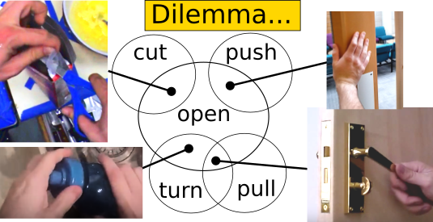
Open Vocabulary and Classification
Languages are large and ambiguous.
Classes overlap with a large number of other classes.
Can lead to high intra-class variance and low inter-class variance.
The standard model of classification doesn’t work.
Notes:
Many videos/actions can be described by a lot of verbs - there’s no clear boundaries between object interactions.

Slide 5
Verb Only Labelling
Do we need the noun at all?
We know a single verb isn’t enough.
By adding more verbs to describe an interaction we can get a greater understanding of it.
How many verbs are enough to discriminate between actions?
Notes:
This came from the idea that the motion of interactions look very similar even with different objects.
Nouns could be added later if required once the interaction has been described.

Slide 6
Verb Only Labelling II
Imagine an action described by:
Open

Slide 7
Verb Only Labelling II
Imagine an action described by:
Open
Pull

Slide 8
Verb Only Labelling II
Imagine an action described by:
Open
Pull
Slide

Slide 9
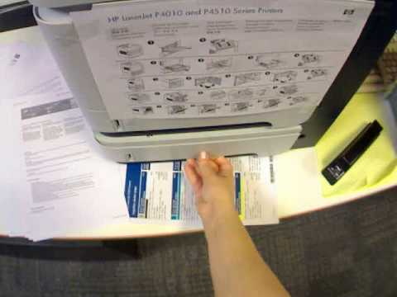
Verb Only Labelling II
Imagine an action described by:
Open
Pull
Slide
Hold
Grab
Touch
...

Slide 10
Collecting Annotations
Three Egocentric Datasets
Egocentric provides a clear view - similar domain to a robot.
A video was chosen from each ground truth class.
We asked 30+ annotators to select all verbs from a list which applied to that video.
Notes:
Egocentric gives a clear view of the interaction taking place.
Each verb was then normalised by the number of annotators in order to get a score between 0 and 1 per verb.

Slide 11
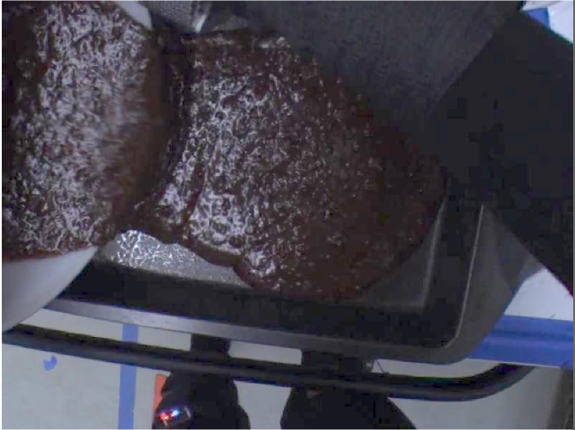
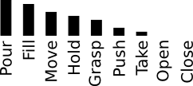
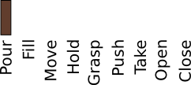
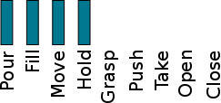
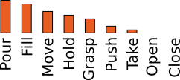
Labelling Methods
Raw Annotations
Verb Noun
Original Label
Pour Brownie
Single Label (SL)
Majority Vote
Multi Label (ML)
Threshold
Soft Assigned Multi Label (SAML)
Continuous Values
Notes:
We want to test three verb only labels along with the original verb-noun label.
SL - majority vote.
ML - Threshold the distribution at 0.5.
SAML - full distribution.

Slide 12
Method for Testing
State-of-the-art two stream fusion network.
Same set-up apart from loss (either softmax cross entropy or sigmoid cross entropy).
1. Feichtenhofer, C., Pinz, A. and Zisserman, A. Convolutional two-stream network fusion for video action recognition. In CVPR 2016.
Notes:
Importantly, we wanted to test what the model is learning with each labelling method - so we keep everything as similar as possible.

Slide 13
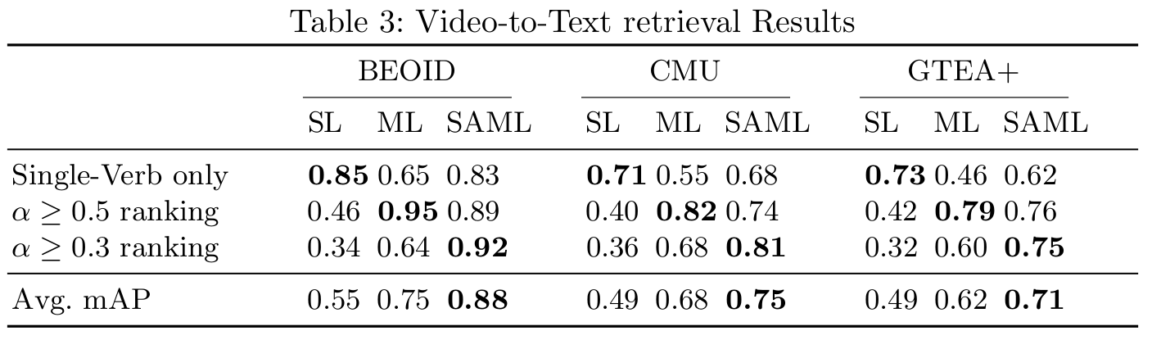
Video-to-Text Retrieval
Treat the output space as an embedding space with each verb score representing a dimension.
SL GT
ML GT
SAML GT
Notes:
We tested retrieval of each method on it’s own ground truth, but also on other labelling method’s ground truth.
This was to show how generalisable each labelling method was.

Slide 14
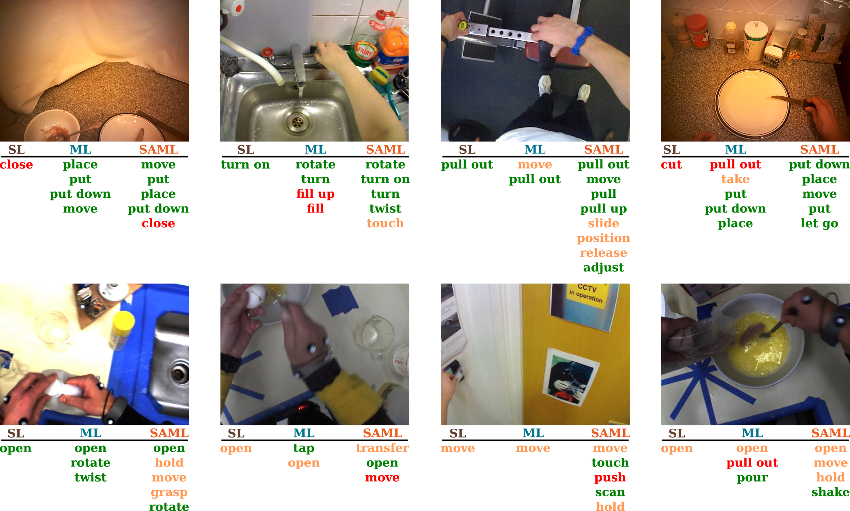
Video-to-Text Retrieval II
Notes:
Some qualitative results - SAML very rarely predicts a totally incorrect verb, but commonly predicts some verbs higher than they were annotated by our annotators.

Slide 15
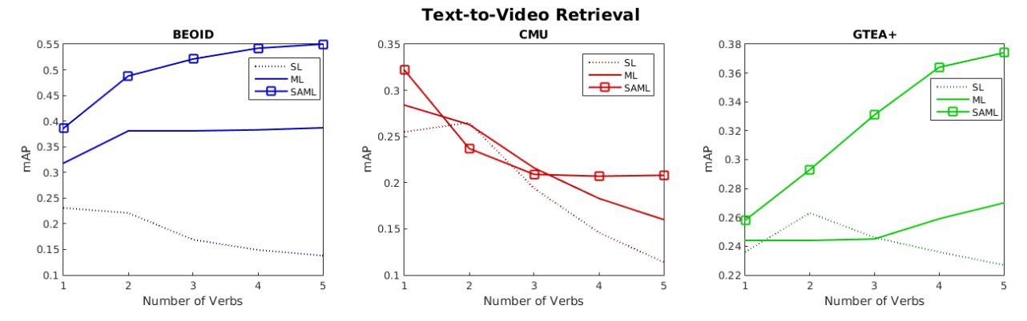
Text-to-Video Retrieval
How many verbs are required for retrieval?
Notes:
This was to show how the number of verbs are required. The drop for CMU comes from how the videos don’t contain a single atomic action.

Slide 16
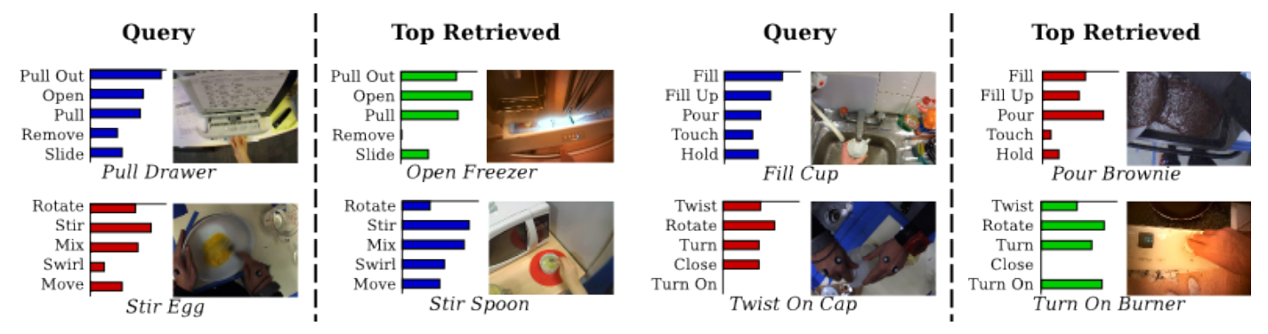
Cross Dataset Retrieval
The embedding space is the same across datasets.
All modalities can be retrieved to and from.
Notes:
Can treat the output distribution as an embedding space - each dimension is a verb.
Input video -> output dist. Find closest output dist -> find corresponding video.

Slide 17
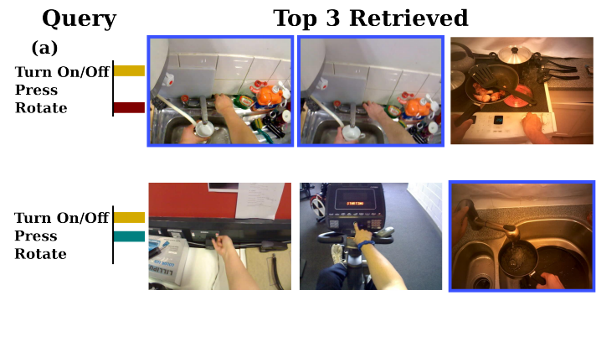
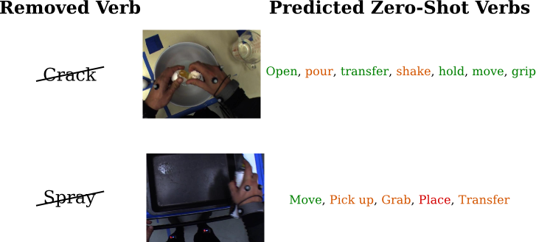
Benefits of a Multi-Verb Representation
We can choose how coarse or fine we wish to perform retrieval.
We can describe actions we haven’t seen before as combinations of others.
Notes:
Benefits of open vocabulary too.
Can differentiate between turn on/off tap by pushing or turning. Or could return all with simply turn on/off.

Slide 18
Conclusion
Using multi-verbs allows for better generalisation of action understanding than verb-noun.
Whilst also allowing for an open vocabulary.
Multi-verb labelling can allow for both fine and coarse grain retrieval.
Zero-shot learning can be performed by piecing together what you already know.

Slide 19
Thank You for Listening
Questions?
Sigurdsson et. al. What actions are needed for understanding human actions in videos?. In ICCV 2017,
Feichtenhofer et. al. Convolutional two-stream network fusion for video action recognition. In CVPR 2016.
Wray et. al. Towards an Unequivocal Representation of Actions. ArXiv 1805.04026. 2018.

